Slide 1
Implementation of Blockchain in IoT
PRESENTED BY
RITWIK RANJAN PATHAK

Slide 2
TABLE OF CONTENTS
Abstract
Introduction
Motivation
Objectives
Word Done So Far
Conclusion And Future Work
References

Slide 3
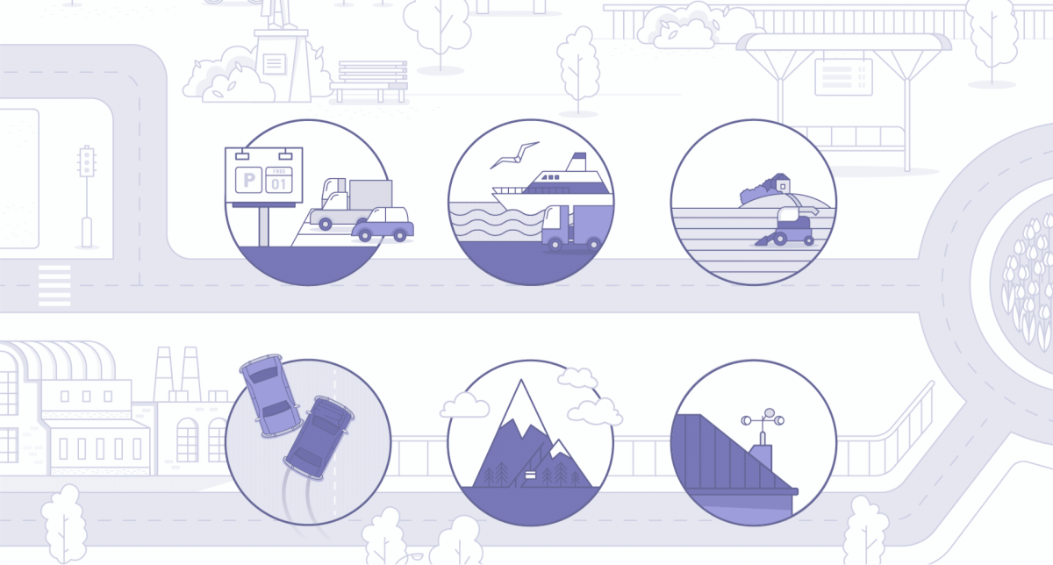
WHAT IS OUR PROJECT ALL ABOUT?
IoT, or, Internet of Things is used to referred to smart devices interconnected in a way which enables them to exchange data with each other.
The major drawback of IoT is that it has a centralized architecture, which makes it prone to security threats and compromises the data.
We aim to develop a tamper free environment to prevent attacks on IoT devices. In order to achieve this, we will implement blockchain technology into IoT application.
The proposed blockchain platform will constantly validate the transactions and enable the devices to interact with each other in a decentralized fashion.
Fig 1: QUITE AN INTERESTING CONCEPT,
WITH MULTIPURPOSE APPLICATIONS!

Slide 4
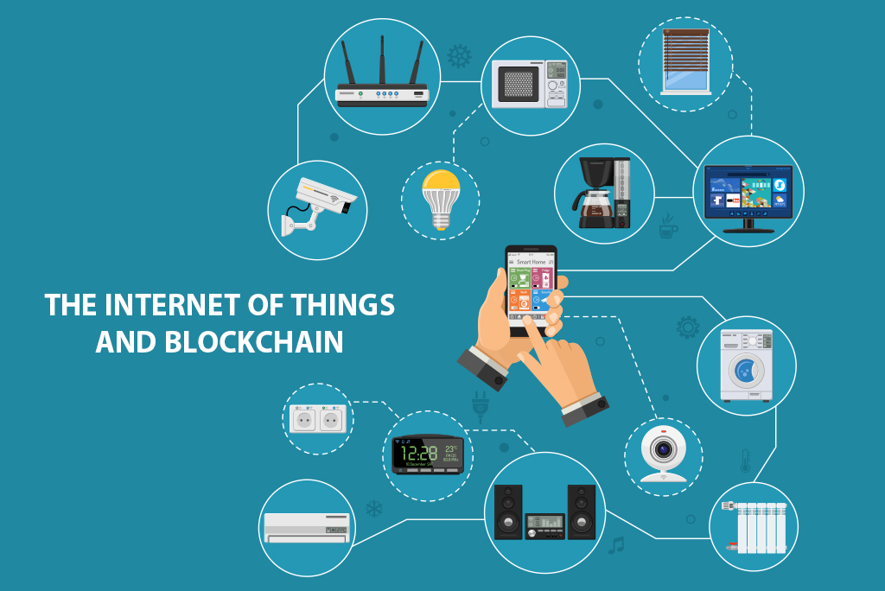
TECHNOLOGY WE WILL BE USING
Raspberry Pi to simulate an IoT network. Due to the blockchain network, the data from RaspberryPi 3.0 and sensors the will be synchronized in the blockchain ledger. The transaction between the computer and Raspberry Pi will be recorded in the blockchain.
Python 3 programming language to create the blockchain structure (compared to linked list data structure). We will code a blockchain technology that will take information and data from the sensors and keep storing the sensitive data in secured blocks using hashing technology.
Fig 2: IoT INTEGRATED WITH BLOCKCHAIN

Slide 5

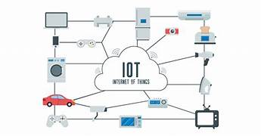
The Two Pillars:
The Foundation Pillars

Slide 6
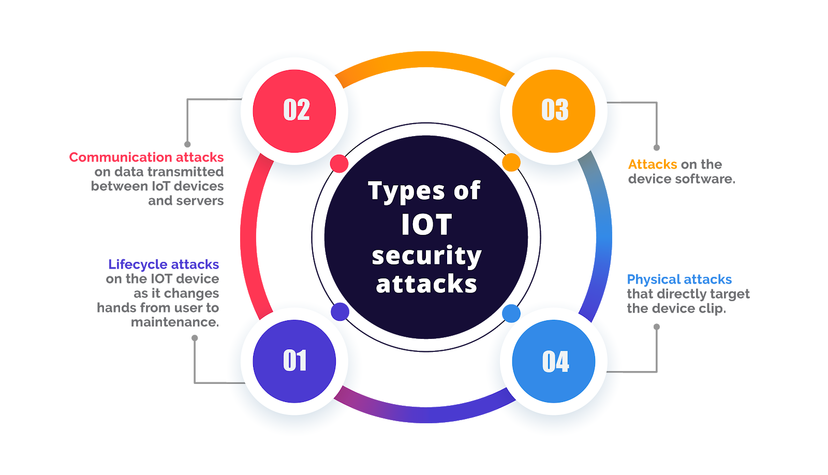
MOTIVATION
Since Blockchain is a completely transparent technology, it will show all the transactions that have been made since its creation, without tampering or fraud.
The proposed blockchain based platform will enable IoT devices to interact with each other in a decentralized and trustless network without the need for a third party intermediary.
With the successful implementation of blockchain in IoT, we will allow advanced technologies to become integrated with IoT too.
From home security systems to environment surveillance, IoT will be more secure and trustworthy to be used in such fields.
Fig 3: TYPES OF IoT SECURITY THREATS

Slide 7
OBJECTIVES
Implementation of IoT using Raspberry Pi 3.0
Implementation of Blockchain
Implementation of Blockchain in IoT using Raspberry Pi 3.0

Slide 8
IMPLEMENTATION OF IoT USING RASPBERRY PI 3.0
To get started with Raspberry Pi 3, we downloaded the Raspbian Jessie image file from the official website.
After connecting Raspberry Pi to a power source, monitor, keyboard, and mouse, we used the terminal to install Python3.
We used the Thonny Python IDE to write and run code for communicating with the sensors.
To ensure proper working of the sensors, we installed the required libraries using the terminal.
With its GPIO (General Purpose Input Output) pins, Raspberry Pi 3 interface with a variety of sensors and device.

Slide 9
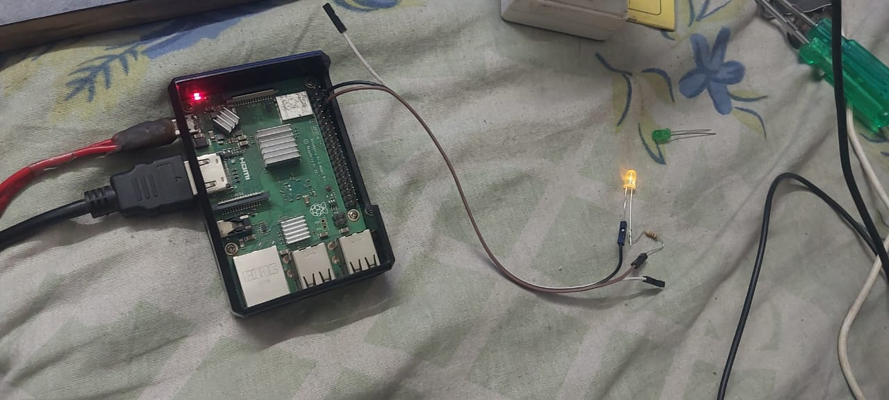
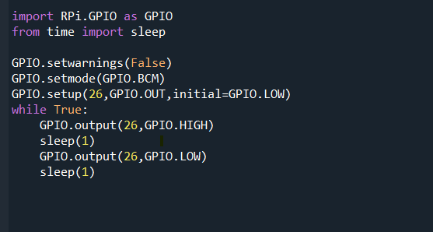
LED BLINKING
THE SENSOR SETUP
PYTHON CODE

Slide 10
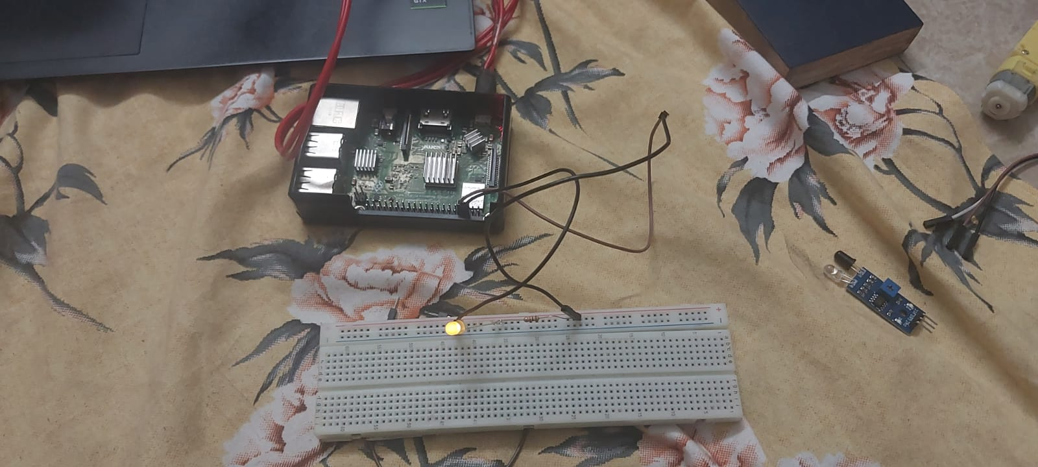
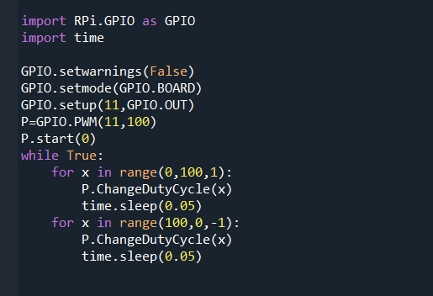
Pulse Width Modulation LED Control
THE SENSOR SETUP
PYTHON CODE

Slide 11
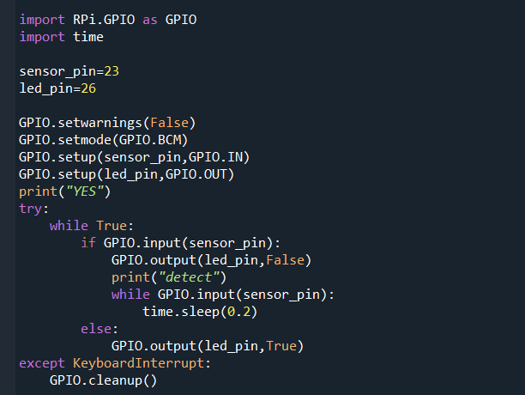
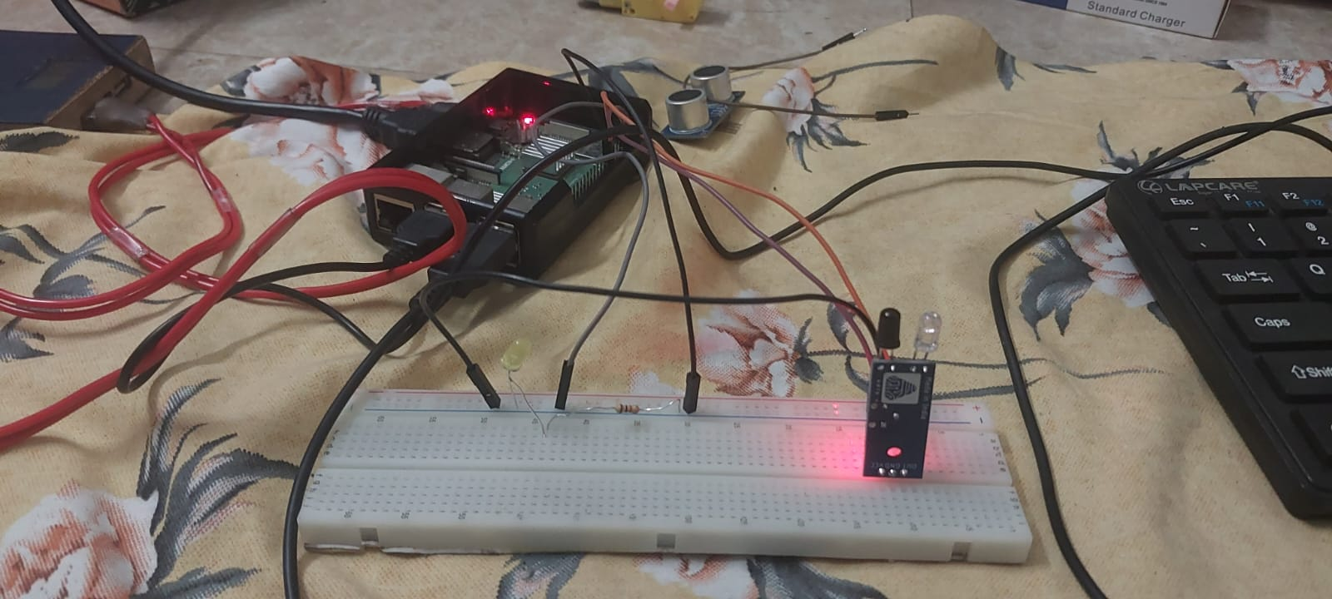
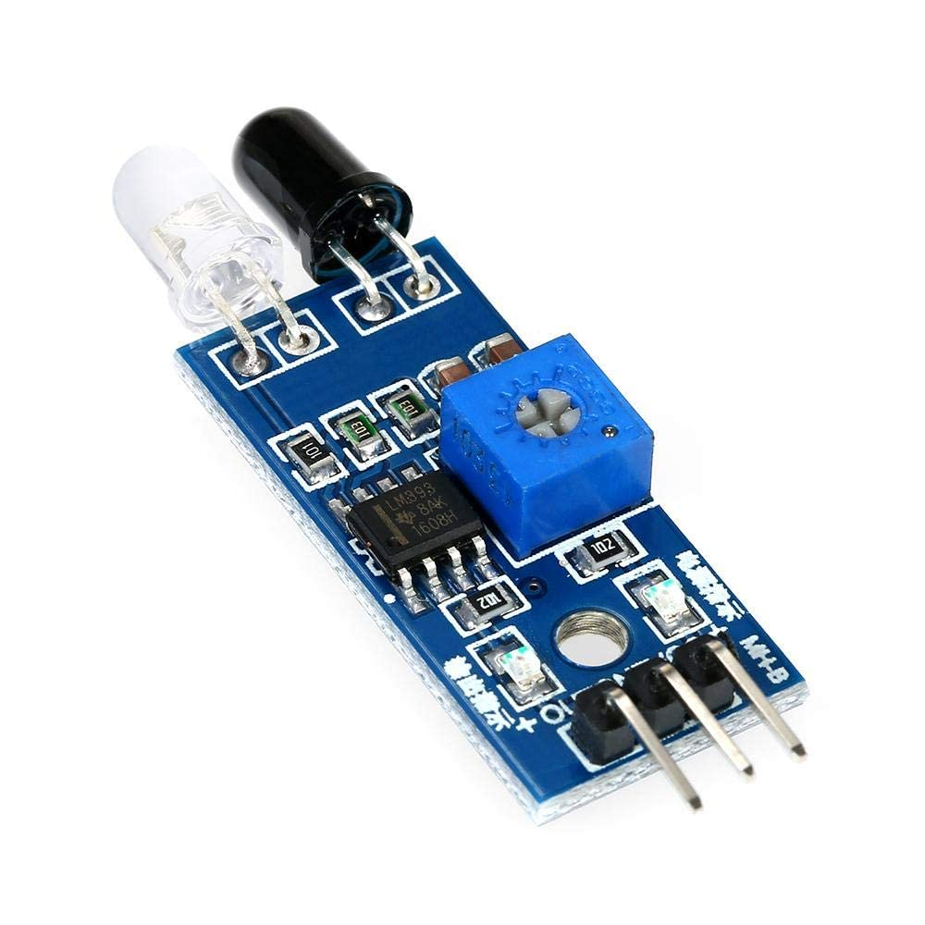
IR SENSOR
THE SENSOR SETUP
PYTHON CODE

Slide 12
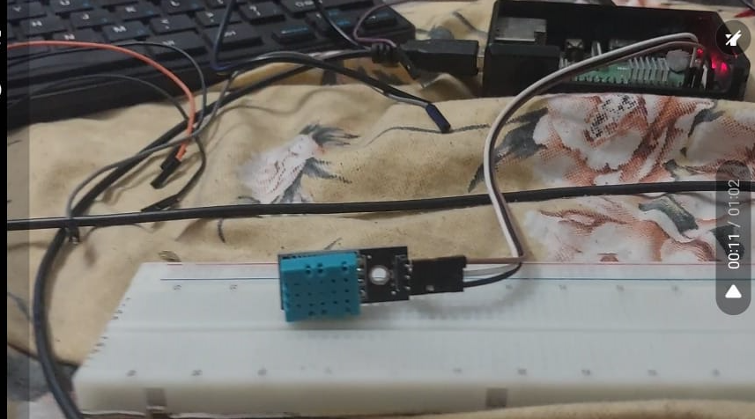
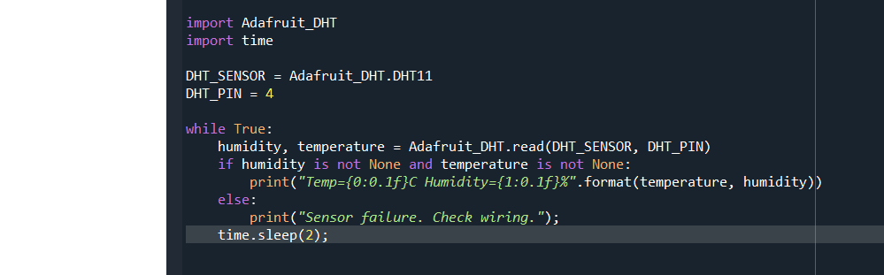
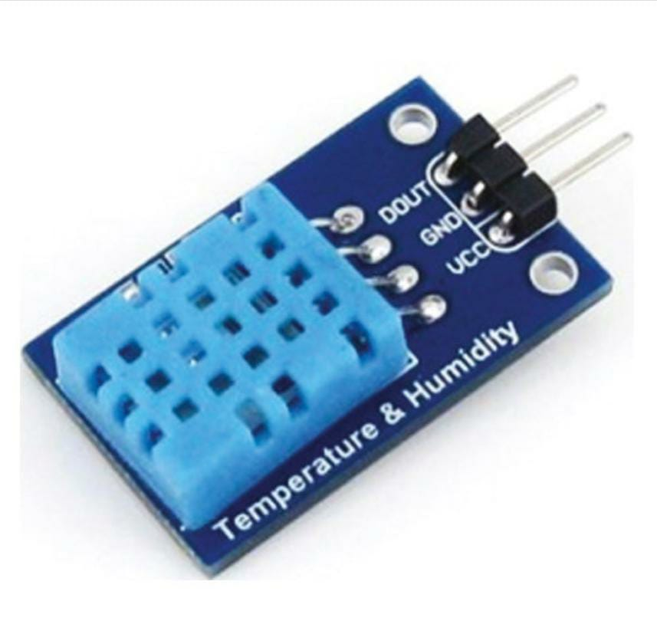
TEMPERATURE AND HUMIIDITY SENSOR
SENSOR SETUP
PYTHON CODE

Slide 13
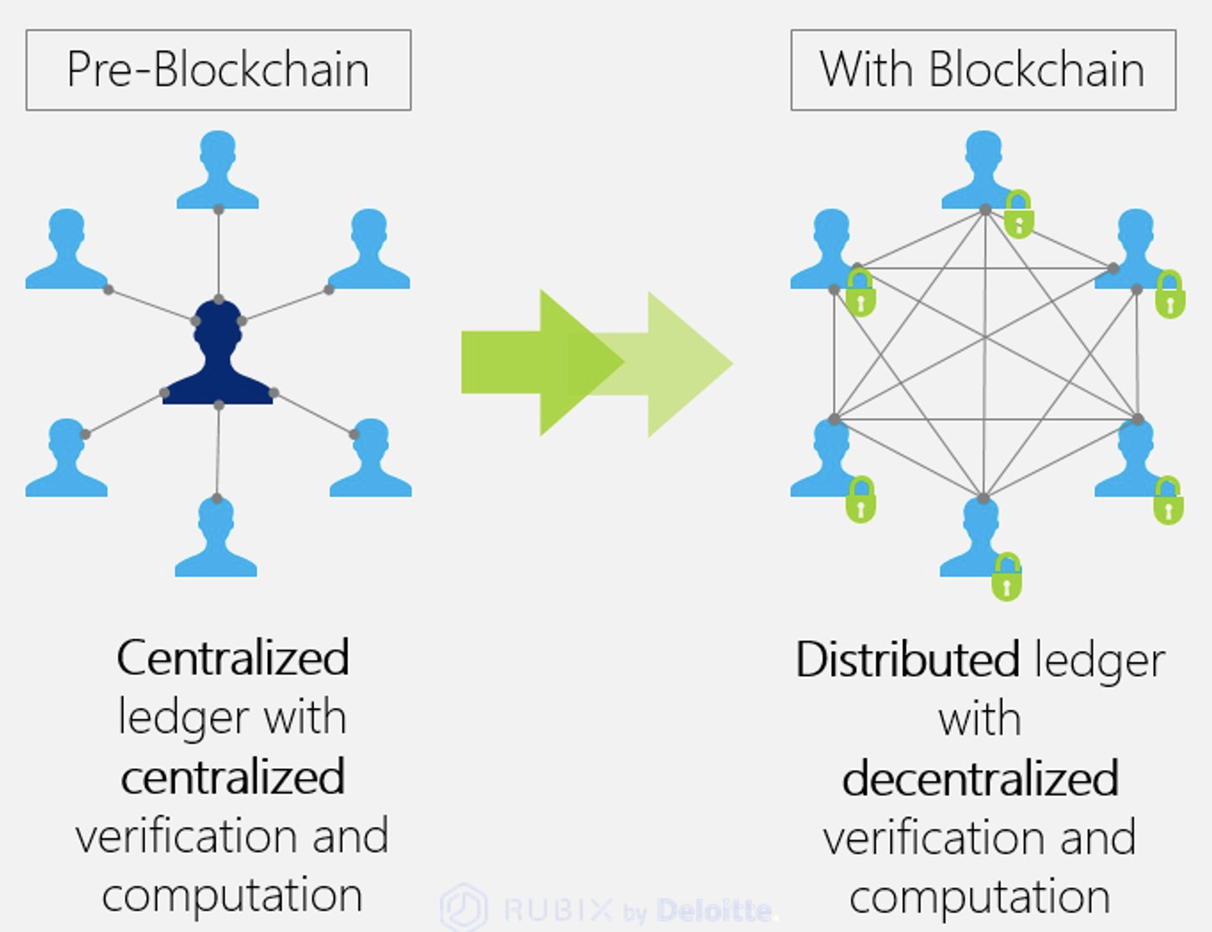
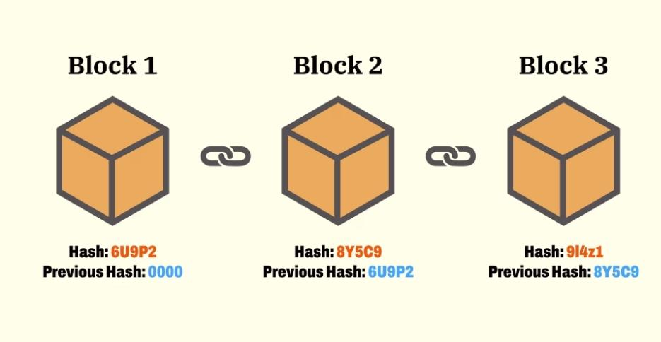
IMPLEMENTATION OF BLOCKCHAIN
At core level, this code creates a basic implementation of a blockchain using Python.
We are using sha256 hashing algorithm for creating the hash. The first block called the ‘Genesis Block' is made automatically and it has no previous hash.
All other blocks are added to the chain by mining process and two blocks are linked by including the hash of the previous block in the current block.
Fig 4: WORKING OF BLOCKCHAIN

Slide 14

IMPLEMENTATION OF BLOCKCHAIN
Proof-of-work algorithm is used to calculate a valid proof for the new block, based on the previous block's proof, the current index, and the new block's data.
We have used method that checks the integrity of the chain by iterating over all blocks in the chain, verifying that the previous hash of the current block matches the hash of its previous block, and that the hash of the current
Fig 5: PROOF OF WORK
·

Slide 15
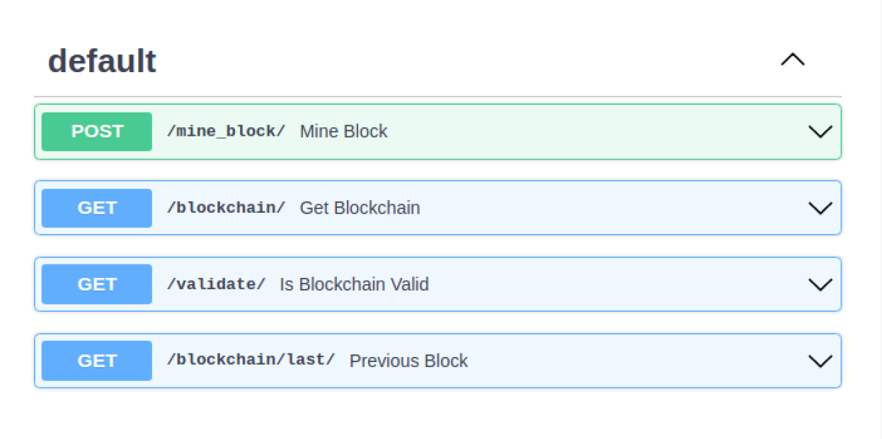
WOKRING OF OUR MODEL (STEP 1)
To enter the block of data
To access the Blockchain
To check the validity
To get the last data inserted
Fig 6: USER INTERFACE

Slide 16
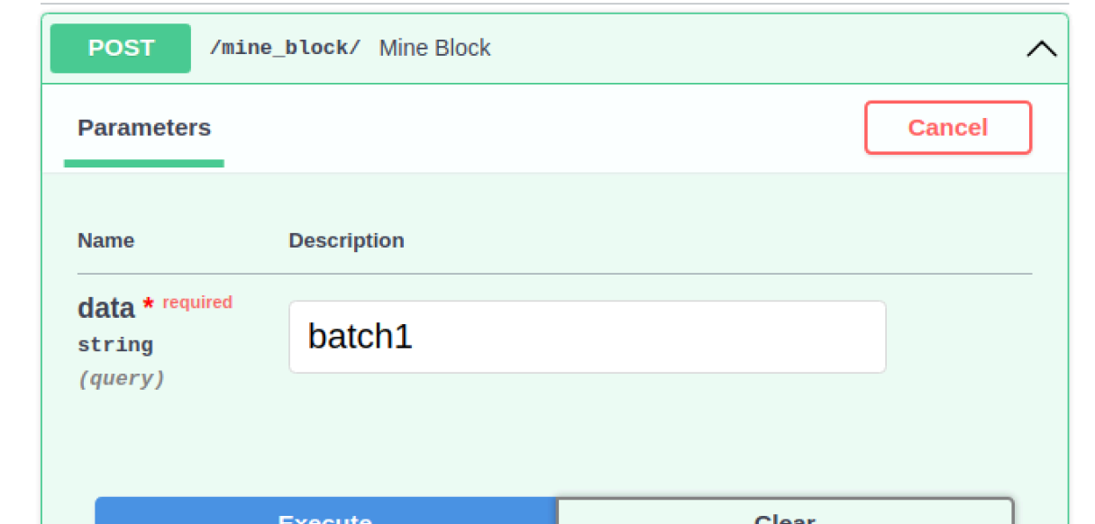
WORKING OF OUR MODEL (STEP 2)
Creating the batch.
The admin can set the block size and the interval of taking the reading as per the requirements
Fig 7: ENTERING THE DATA

Slide 17
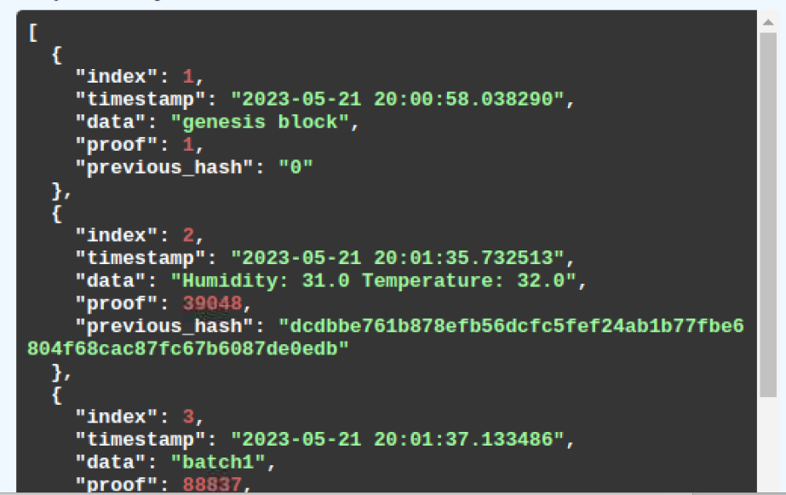
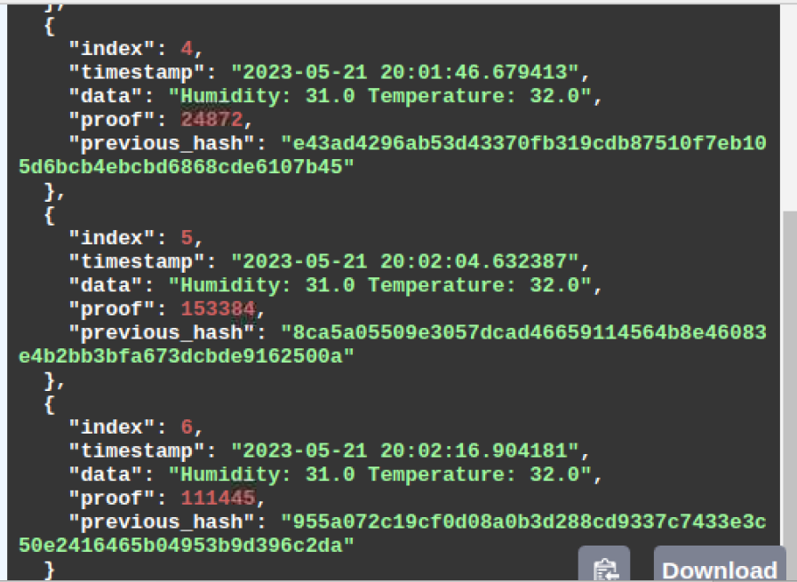
FINAL OUTPUT:

Slide 18
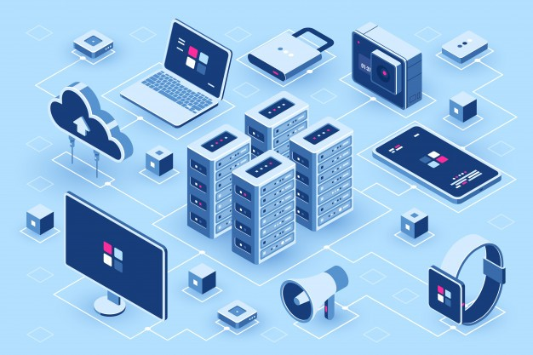
CONCLUSION
We have successfully created a Blockchain class that implements a simple blockchain data structure. This code defines a basic implementation of a blockchain using Python.
We have developed a method for updating the blockchain ledger and also mode method for validating our blockchain. This ledger securely stores the information and data collected by the sensors with the help of Raspberry Pi 3.
As the data is collected, it is secured in the blockchain network.
We have also linked our blockchain with our own API taking the base as Fast API so that we can remotely access our blockchain from anywhere. Thus, IoT security is ensured.
Fig 8: WIDE RANGING APPLICATIONS OF IoT

Slide 19
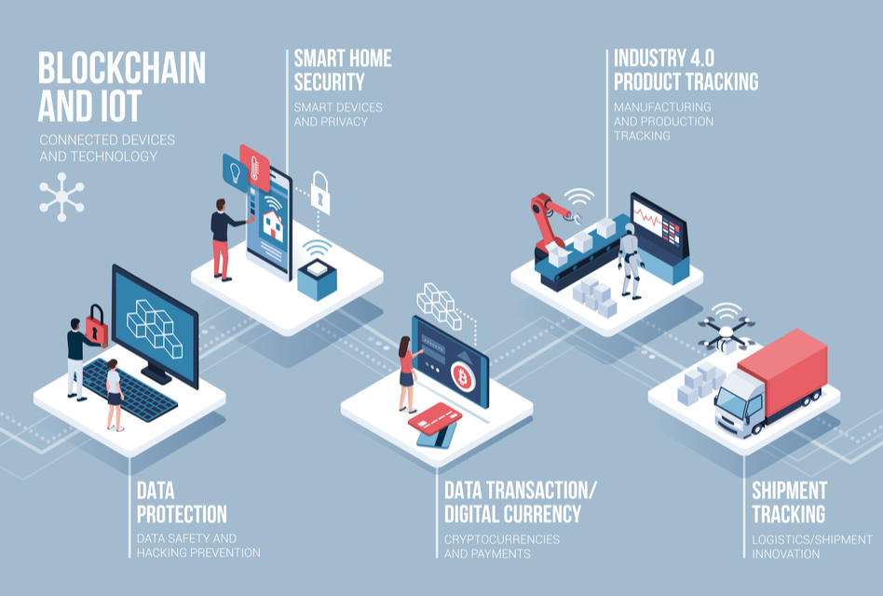
FUTURE WORK
WE WILL WORK ON THE FOLLOWING METHODS TO IMPROVE OUR PROJECT:
We shall add Consensus Algorithm to ensure that all the nodes on the network agree on the validity of a transaction before it is added to the blockchain.
Will improve the algorithm efficiency by using Solidity and some more advanced fast and efficient programming language specifically designed for Blockchain
Fig 9: FUTUTRE SCOPE OF BLOCKCHAIN AND IoT INTEGRATION

Slide 20
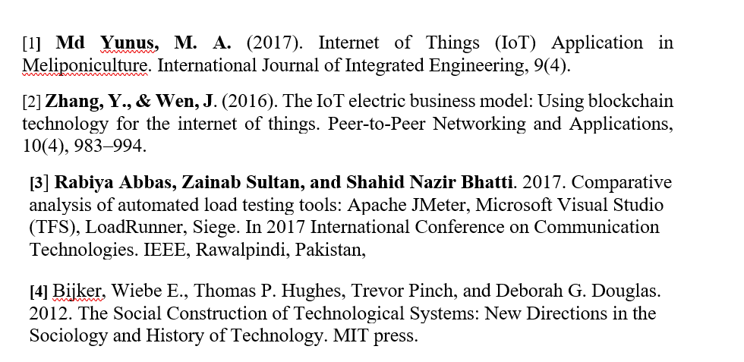
REFERENCES

Slide 21


